Slide 1



E-Waste and its Management
Department of Chemistry
Kongu Engineering College
Perundurai

Slide 2
E-Waste and its Management
E- Waste – definition - sources of e-waste– hazardous substances in e-waste - effects of e-waste on environment and human health- need for e-waste management– e-waste handling rules - waste minimization techniques for managing e-waste – recycling of e-waste - disposal treatment methods of e- waste – global Scenario of E-waste – E-waste in India- case studies.

Slide 3
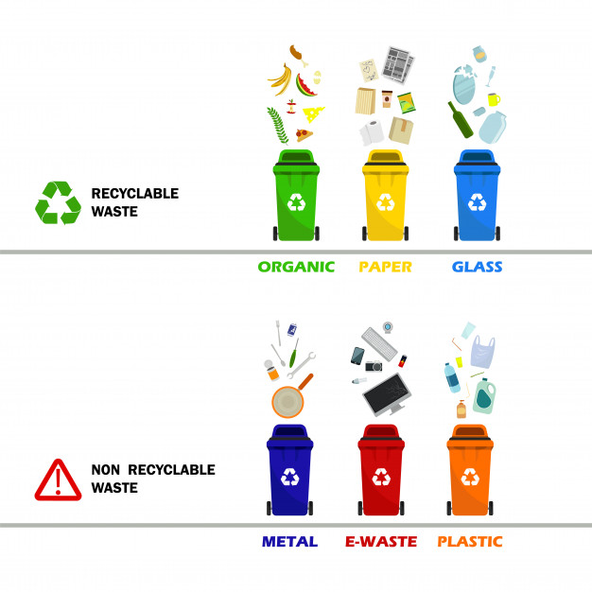

Waste
Waste is an outcome of product or a substance that is no longer suited for its intended use.
Hazardous and non hazardous waste.
Non-hazardous waste is any waste that does not cause harm to people or the environment, and regulations for disposal of non-hazardous waste are less strict.
Non-Hazardous Waste - Threat to human health and the environment if it is not handled properly.
Industrial, biomedical waste, Electronic & electrical equipment are the examples
Highly required to be disposed off as per national laws.

Slide 4
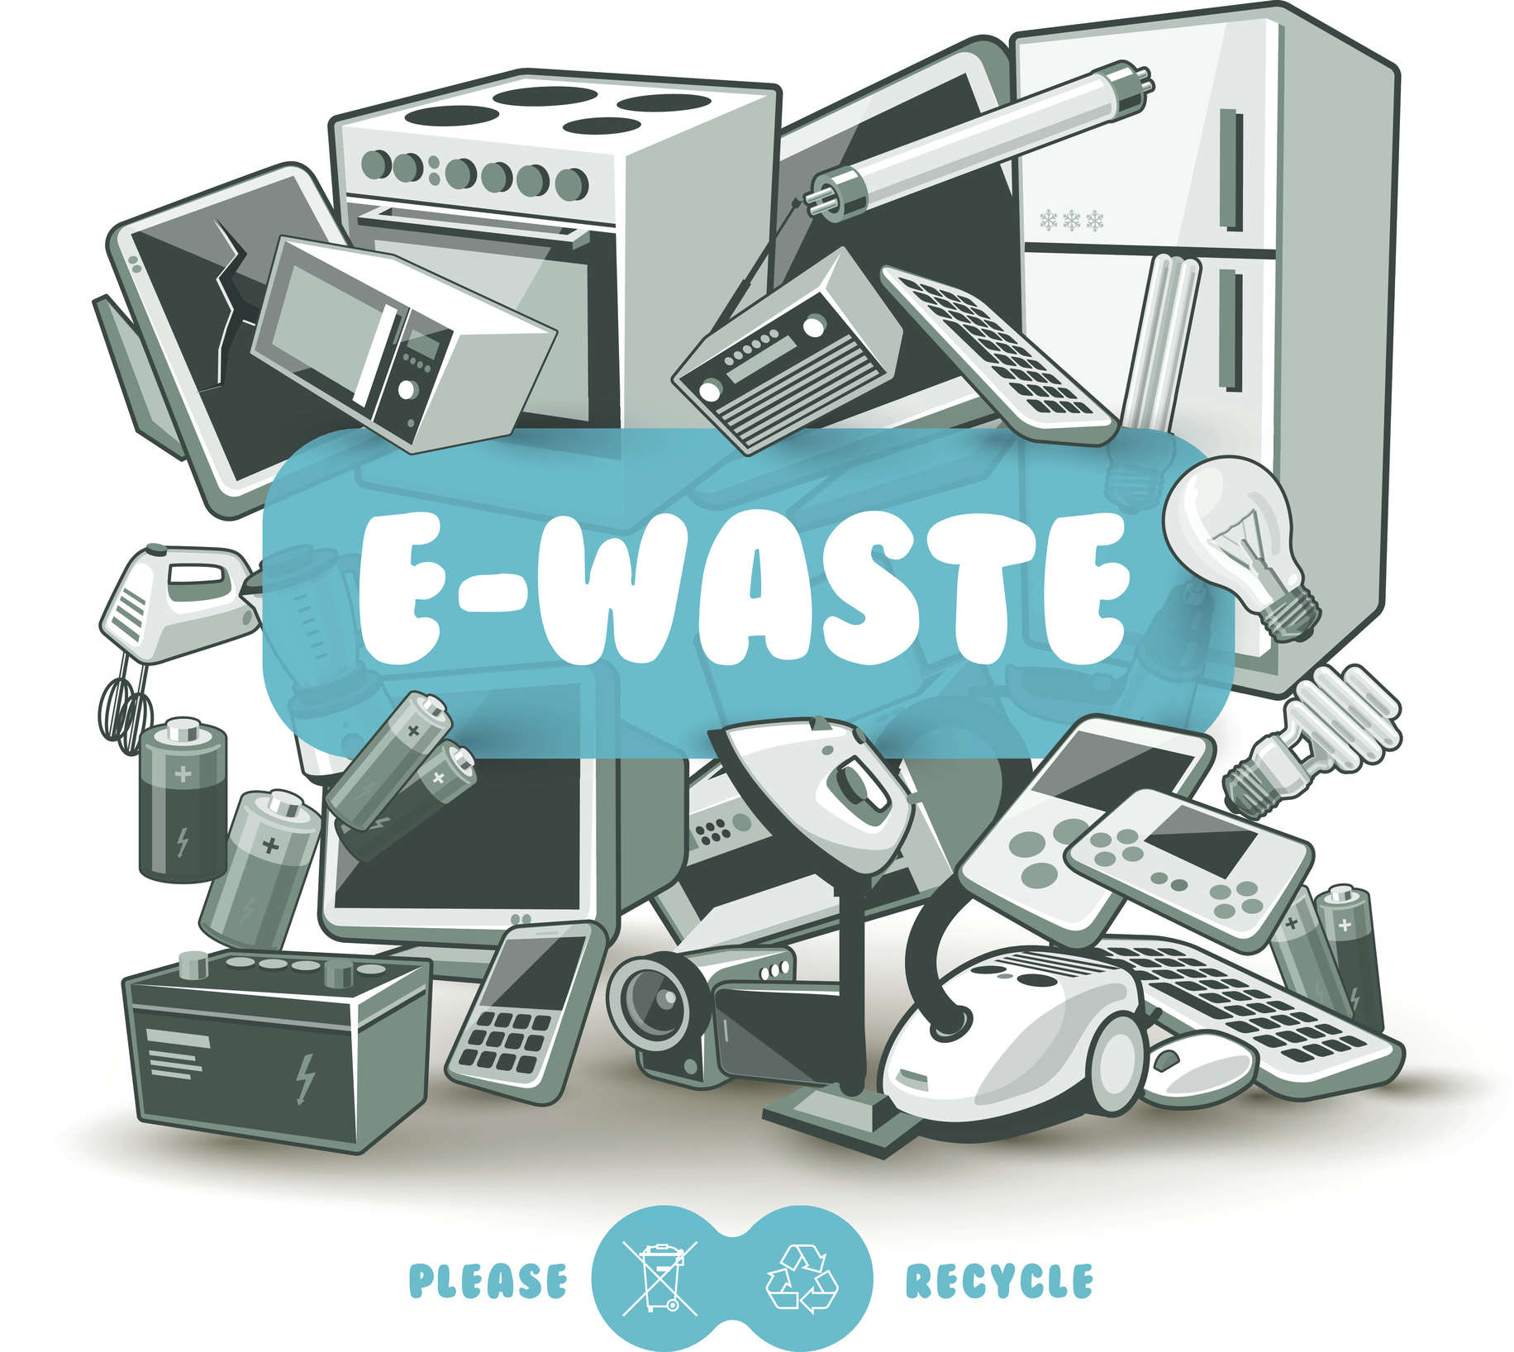
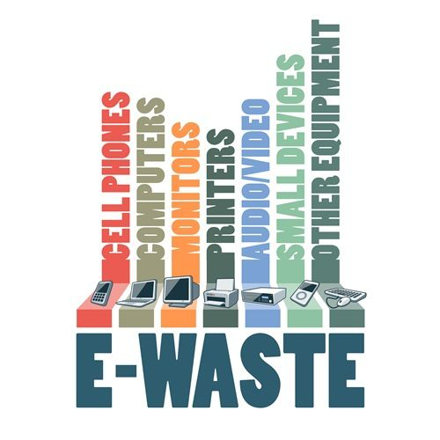
E - Waste
Any form of electrical and electronic material or body discarded after its usage or expiry.
E-Waste comprises of a broad and growing range of electronic devices, ranging from large household devices such as refrigerators, air conditioners, cell phones, personal stereos, and consumer electronics to computers, printers which have been discarded by their users.
With the presence of deadly chemicals and toxic substances in the electronic gadgets, disposal of E-Waste is becoming an environmental and health nightmare.
Globally only 15 – 20 percent of E-Waste is recycled while the rest is dumped into developing countries such as India, China and Nigeria.

Slide 5
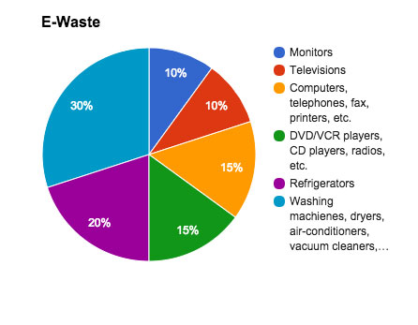
Sources of E-waste
Sources
Large Household Appliances
Small Household Appliances
Products used for data processing
Devices used for communication
Electronic devices used for entertainment
Automatic dispensers
Medical devices used for treatment
Toys, leisure and sports equipment

Slide 6
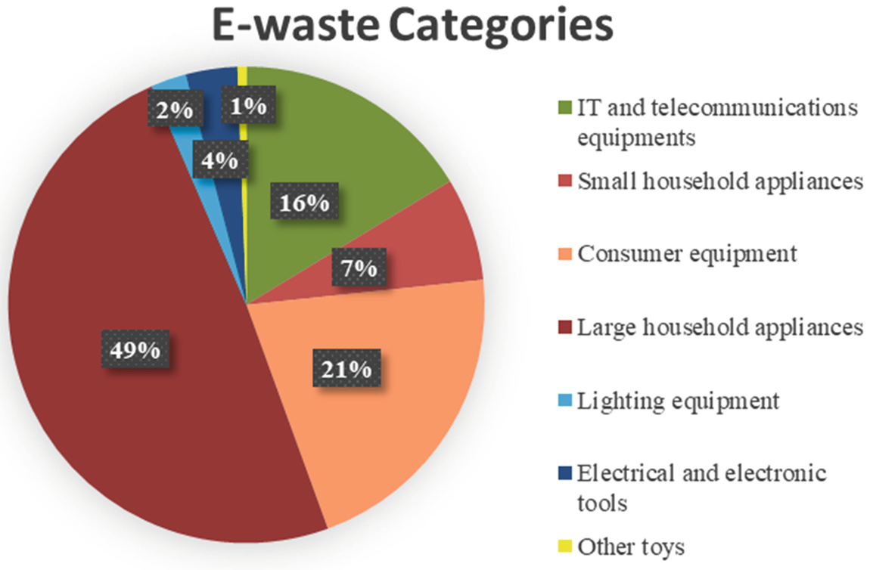
Categories of E-waste
Large equipment such as washing machines, clothes dryers, dish washing machines, electric stoves, large printing machines, copying equipment and photovoltaic panels.
Small equipment comprises of vacuum cleaners, microwaves, ventilation equipment, toasters, electric kettles and electric shavers.
Small IT and telecommunication equipment. For example, mobile phones, GPS, pocket calculators and routers etc.

Slide 7
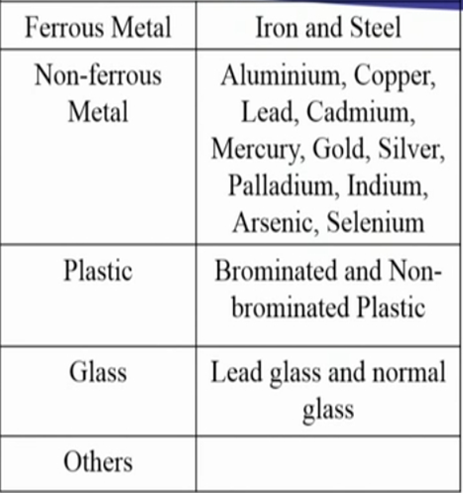
Constituents of E-Waste
36% → Ferrous metals ie) Iron and Steel
19% → Non-ferrous metals, like Cu, Al and precious metals like Ag, Au, Pt, Pd etc.,
23% → Plastic
15% → Glass
7% → Others (rubber, wood, ceramic etc)
Also contain toxic elements like americium-241, Pb, Hg, Ar, Cd, Se and Cr etc.,

Slide 8
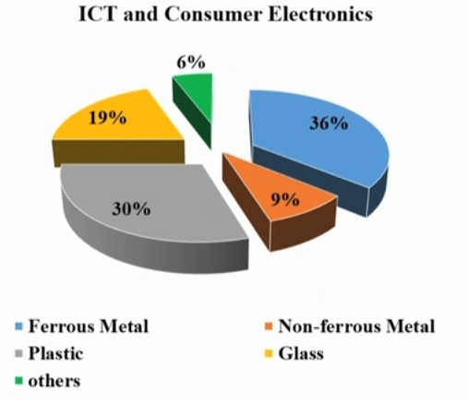
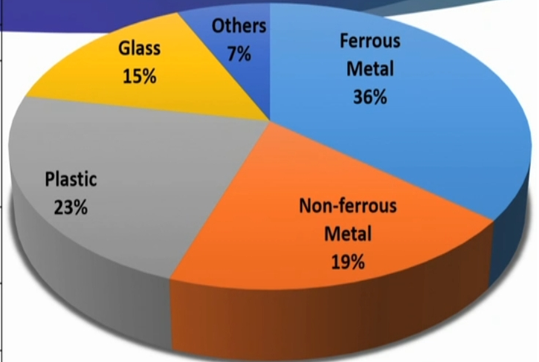
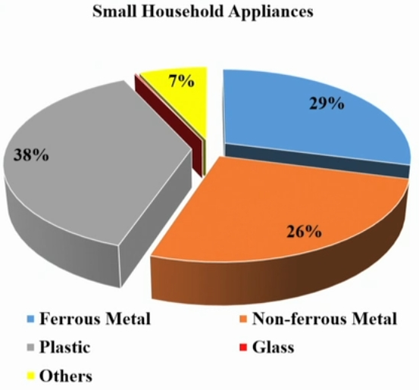
Constituents of E-Waste
Constituents of E-Waste in near 2020’s
Constituents of E-Waste in near 2010’s

Slide 9
Effects of E-waste on the environment and human health
S. No. | E-Waste component | Occurrence in electric appliances | Adverse health and environmental effects
1 | Americium 241 | Smoke detectors and some medical equipment | Carcinogenic leads to cancer and radiactive in nature
2 | Pb | Lead-acid and Li batteries CRT monitor glass, solar, transistors, lasers, LEDs and circuit boards | Impaired cognitive function, behavioral disturbances, attention, hyperactivity and lower IQ. Neurotoxin that affects the kidneys and the reproductive system. • It leads to water and soil pollution.
3. | Hg | Found in fluorescent tubes, tilt switches, CCFLs backlights, Components in copper machines, batteries in clocks and pocket calculators, LCDs | It causes dermatitis, sensory impairment and muscle weakness. Affects the central nervous system (memory loss), kidneys and immune system. It impairs foetus growth and harms infants through mother’s milk. • Environmental effects in animals include death, reduced fertility, and slower growth and development

Slide 10
S. No. | E-Waste component | Occurrence in electric appliances | Adverse health and environmental effects
4 | Cd | NICAD batteries, light sensitive resistors, pigments, solder, alloys, circuit boards, computer batteries, monitor cathode ray tubes (CRTs) | carcinogen, Long-term exposure causes Itai-itai disease, which causes severe pain in the joints and spine. It affects the kidneys and softens bones Severe damage to the lungs and kidney. • Deficits in cognition, learning behaviour skills in children. • Pollute water and soil.
5 | Cr(VI) | common element in electronics due to its ability to prevent corrosion and the increased conductivity of electrical impulse, Dyes/pigments, switches, solar. | Carcinogenic leads to cancer can damage liver and kidneys and cause bronchial maladies including asthmatic bronchitis Inhaling hexavalent chromium - lung cancer.
6 | S | Found in lead-acid batteries | It causes health effects that include liver damage, kidney damage, heart damage, eye and throat irritation. • Acidic nature is created in the environment due to the formation of sulphuric acid through sulphur dioxide.

Slide 11
S. No. | E-Waste component | Occurrence in electric appliances | Adverse health and environmental effects
7 | Brominated Flame Retardants | Flame retardants in plastics in most electronics (Casing, circuit boards (plastic), cables, PVC cables) (releases toxic emissions including Dioxins) | Impaired development of the nervous system, thyroid problems, severe hormonal disorders, liver problems are some health effects due to prolonged exposure.
8 | Perfluorooctanoic acid | Used as an antistatic additive in industrial applications. Found in electronics and in non-stick cookware (PTFE) appliances. Environmental degradation results in the formation of PFOA. | Immune toxicity, hormonal effects and carcinogenic effects have been found out from studies in mice. • It leads to increased maternal PFOA levels which are associated with an increased risk of spontaneous abortion (miscarriage) and stillbirth.
9 | Beryllium oxide | Filler used in materials such as thermal grease used on heat sinks for CPUs and power transistors, X-ray transparent ceramic windows, heat transfer fins in vacuum tubes and gas lasers. | Occupational exposures lead to lung Cancer, Chronic Beryllium Disease (beryllicosis), a disease which primarily affects the lungs. Exposure to beryllium also causes a form of skin disease that is characterized by poor wound healing and wart-like bumps

Slide 12
S. No. | E-Waste component | Occurrence in electric appliances | Adverse health and environmental effects
10 | Arsenic | Semiconductors, diodes, microwaves, LEDs (Lightemitting diodes), solar cells | Chronic exposure to arsenic can lead to various diseases of the skin and decrease nerve conduction velocity. Chronic exposure to arsenic can also cause lung cancer and can often be fatal
11 | Barium | Electron tubes, filler for plastic and rubber, lubricant additives | Short-term exposure to barium could lead to brain swelling, muscle weakness, damage to the heart, liver and spleen. Animal studies reveal increased blood pressure and changes in the heart from ingesting barium over a long period of time
12 | Copper | Conducted in cables, copper ribbons, coils, circuitry, pigments | Nausea, Vomiting, Diarrhea, Liver Damage, Kidney Damage, Death

Slide 13
Need for E-waste Disposal
E Waste has been identified as the fastest growing waste stream in the world : forecast to soon reach 40 million tons a year.
The volume of e-waste is rising about three times faster than any other forms of municipal waste.
Contains over 1000 different substances including toxic heavy metals and organics which can pose serious environmental pollution problem upon irresponsible disposal.
Includes deadly chemical and metal such as lead, cadmium, brominated flame retardants, phthalates etc.
Long term exposure to these substances damages the nervous system, kidney, bones, reproductive and endocrine systems. (Carcinogenic and neurotoxic)
Pollutes water, air and soil quality.
Can be overland mine for specific metals.
Many valuable substances are also found in e-waste along with hazardous substances can be used as a source material in different industries.

Slide 14
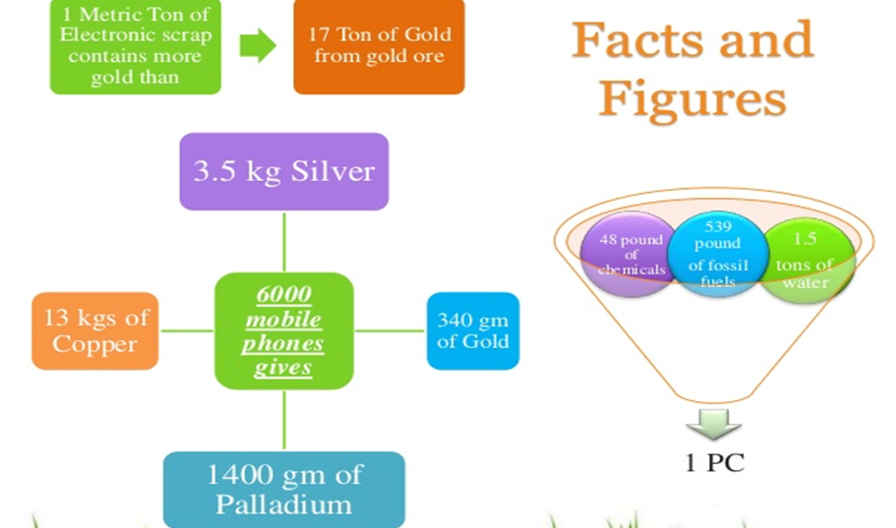
This helps in the conservation of earth’s resources
By recycling e-waste, we can identify the non-hazardous materials that can be reused in many applications

Slide 15
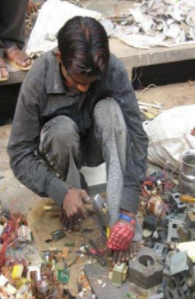
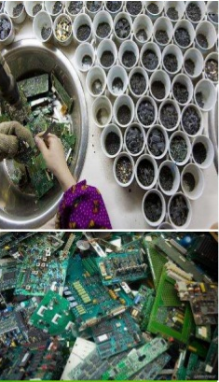
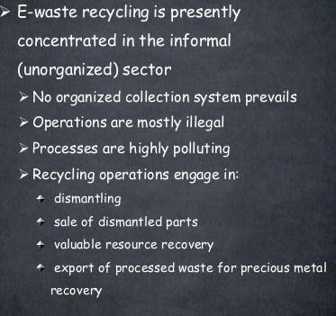
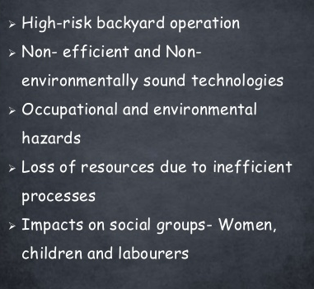
Recycling Scenario and informal recycling concerns

Slide 16
Objectives of E waste rules
To Minimize illegal recycling and to promote safe recovery operations by channelizing E-waste to registered E-waste recyclers.
Extended Responsibilities to producers to manage the system of E-waste collection/take back and channelizing to a registered dismantler/recycler
Reduce Hazardous substances in Electrical and Electronic components.
To regulate the generation, collection, storage, transportation, import, export etc.

Slide 17
E-waste (Management & Handling) Rules and Guidelines
Regulatory frameworks in India
E-waste (Management & Handling) Rules under the Environment Protection Act 2011
Notified on 12th May 2011 and Became effective from May 2012
The basic objective is to put in place an effective mechanism to regulate the generation, collection, storage, transportation, import, export, environmentally sound recycling, treatment and disposal of e-waste.
This includes refurbishment, collection system and producer responsibilities thereby reducing the wastes destined for final disposal
E-waste (Management & Handling) Rules under the Environment Protection Act 2015
Notified on 10th June 2015
Objectives are same as mentioned above with some omission and additions.

Slide 18
In the year 2016, Ministry of Environment, Forest and Climate Change (MoEFCC) have amended the the E-Waste (Management) Rules, 2016 in supersession of the 2011 Rules, to simplify and effectively implement E-waste management practices in India.
came into effect from 1st October, 2016.
Under this act, a manufacturer, dealer, refurbisher and Producer Responsibility Organization (PRO) were also brought under the ambit of these Rules.
Recently in 2018, the rules have been amended to facilitate and effectively implement the environmentally sound management of e-waste in India.
Notified on 22nd March, 2018
These amendments have been made with the objective of channelizing the e-waste generated in the country towards authorized dismantlers and recyclers in order to further formalize the e-waste recycling sector.

Slide 19
Salient features E-Waste (Management) Rules, 2016
The salient features of new e-waste management rules are as follows
Includes additional stakeholders like manufacturer, dealer, refurbisher and Producer Responsibility Organization (take the responsibility for collection and channelization of e-waste generated from the 'end-of-life' of their products).
It covers Compact Fluorescent Lamp (CFL) and mercury lamp .
It permits the producer to charge an additional amount as a deposit at the time of sale of the electrical and electronic equipment. At the end-of life, consumer can return the equipment and can get back the deposit amount along with interest. For example automobile workshops pays certain amount for the used batteries.
It provides option for e-waste exchange.
The State government has been given power to ensure safety, health and skill development of the workers involved in the dismantling and recycling operations.

Slide 20
It has given responsibility to the dealer for collecting and channelizing the e-waste on behalf of the producer.
Now the manufacturer also responsible to collect e-wastes generated during the preparation of the product and channelize it for recycling or disposal and seek authorization from SPCB.
The existing and upcoming industrial park, estate and industrial clusters should allot place for e-waste dismantling and recycling process.
It emphasizes (Department of Labour in the State or any other government agency) to ensure recognition and registration of workers involved in dismantling and recycling and the safety and health of workers too.
The State government should submit the annual report comprising of integrated plan for effective implementation of these provisions to MoEFCC.
The transportation of e-waste shall be carried out with the documents (3 copies) prepared by the sender with complete detail on the e-waste.

Slide 21
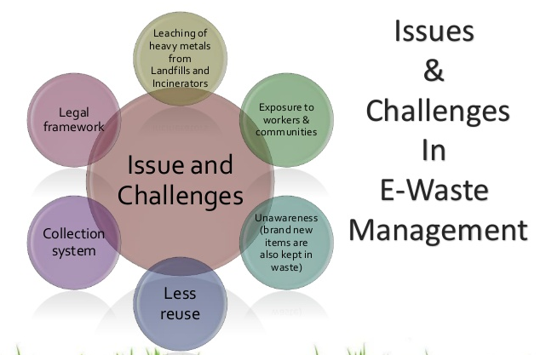

Slide 22
Management of E-waste
Approximately 75% of used electrical and electronic items are simply stored as scrap in houses, offices etc., due to the technological advancement and the short lifespan of products.
Hence it is necessary to implement proper e-waste management techniques.
In industries management of e-waste should begin at the point of generation. This can be done by E-Waste Management
1. waste minimization technique
(generation of waste is reduced at all stages of Product manufacturing)
Inventory management
Production-process modification
Volume reduction
Recovery and reuse
2. sustainable product design
(waste generation is minimized while planning and designing a product)
Design product with lesser hazards
Use of renewable materials and energy
Conservation of non-renewable materials with reusability

Slide 23
1. Waste minimization technique
Inventory management – Ensures the needed quantity of materials are used
management of raw material consumption during manufacturing process
reduce the use of hazardous material and excessive use of raw material
1. Establishing material purchase review and control procedures
review all the material needed for making product
prior to purchase all the raw materials are scrutinized to find the presence of any hazardous substance
2. Inventory tracking system
strict monitoring has to be done to ensure that only the needed quantity of a material is consumed.
II. Production-process Modification
modify the manufacturing process to reduce waste generation
1. raw material change - replace hazardous material with less or non-hazardous material

Slide 24
2. Process-equipment Modification - installing new or updated instruments for the efficient use of raw materials to reduce waste generation
3. Improved Operating and Maintenance Procedures
follow the standard procedures for making products
periodical maintenance of equipments
organizing a training program to employees to explain the correct operating and handling procedures, proper equipment use, maintenance schedules and proper management of waste materials
III. Volume reduction – removing hazardous material from the non-hazardous portion of e-waste
reduce the quantity or volume and cost of of disposing the waste material
different types of valuable metals can be separated and recovered from e-waste widely used methods for concentration of e-waste include gravity and vacuum filtration, ultra filtration, reverse osmosis, freeze vaporization, etc

Slide 25
IV. Recovery and Reuse
valuable materials are recovered from waste and reused for making secondary products this method reduces the raw material cost
recovery process may be done either from an onsite or offsite recovery facility through inter-industry exchange
methods include reverse osmosis, electrolysis, condensation, electrolytic recovery, filtration, centrifugation
2. Sustainable Product Design
Efforts should be made to design a product with less amount of hazardous material
maximum use of renewable materials and energy
manufacturers should ensure that the products made with non-renewable materials are built for reuse, repair and recyclability.

Slide 26
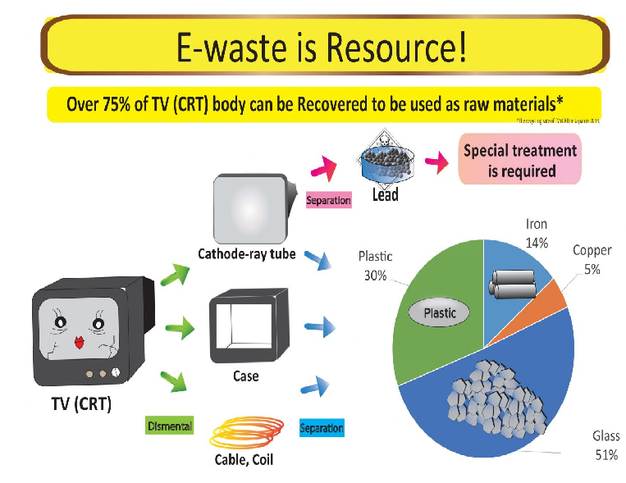
Electronic waste contains a various type of metals and materials which can be recycled. Taking TV (CRT) for example, it contains copper, iron, glass and plastic in its body, and over 75% of the body can be recovered to be used as raw materials.

Slide 27
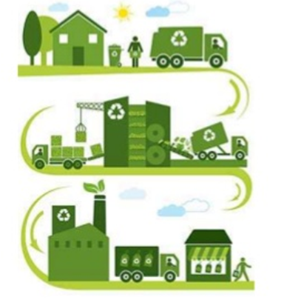
Steps in E- waste Management
E-Waste management includes the following activities
Collection of E -Waste
Transportation of E -Waste
Sorting of E – Waste
Processing of E – Waste
Repairing of E – Waste
Dismantling
Recycling
Component recovery of E-waste
Residual disposal of E-waste

Slide 28
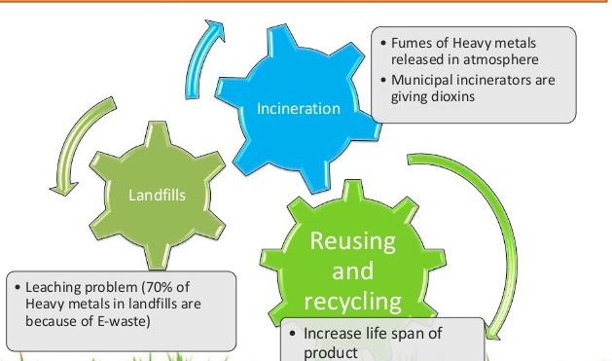

Slide 29
Recycling and Disposal methods
Land filling
Incineration
Acid baths
Land filling
Common way of disposing wastes
Landfill is constructed by excavating soil and made trenches for burrying e-waste.
Clay and plastics are used as impervious layer to hold e-waste and thus preventing leachate to enter underground.
Termed as toxic time bomb – release toxic substance into soil and underground as well as surface water bodies. (Heaps of e-waste are thrown on land, polluting air, water and soil).
Leachates penetrate into the soil and reaches the underground water and introduce lethal toxicity.
Kidney damage and brain damage – genetic mutations
Half of E-waste in US and Australia is dumed in Landfills while rest is exported to developing countries of Asia and Africa.
Can recover some products

Slide 30
Incineration
controlled way of disposing e-waste and reduce its volume
energy obtained can also used separately (heat to electrical)
Two ways – Incineration, Pyrolysis and gasification
Gasification -Involves combustion of waste at higher temperature (900-1000 °C) with limited supply of air
Main disadvantage is that it emits hazardous substance into environment such as dioxins, mercury, cadmium etc
Pyrolysis – heating in absence of O2.Substances are directly converted into fume, ash and tar.
For example PVC circuit board is heated, it releases carcinogens such as polycyclic aromatics, polychlorinated dibenzo para dioxins, polychlorinated dibenzo furans and CO, SO₂, No_{x}. Smoke also consists of heavy metal oxides (Sn,Sb, Pb, As, Cu, Mn, Hg, Ni, etc).
Acid bath
E-waste products are soaked in concentrated H₂SO₄, HCl, HNO₃ solutions which dissolves the metals and can be recovered. (generally precipitating methods)
Generally used to extract copper, lead, silver and gold like metals.
Hazardous acid waste is discarded in local water bodies
For Example, Cu in Circuit board is submerged in H₂SO₄ for about 12 hrs to dissolve Cu and obtained green solution is boiled to form CuSO₄

Slide 31
Global Scenario of E-Waste
The global growth in electrical and electronics equipment production and its consumption has increased day by day enormously due to technological boom.
The main reason is increasing market penetration of products, development of a replacement market and high product obsolescece rate.
As a impact, there is a constant decrease in the price and increase in the internet usage.
The World Health Organization (WHO) and the German Ministry of Economic Cooperation and Development also substantially contributed to this year’s Global E-waste Monitor 2020.
A record 53.6 million metric tonnes (Mt) of electronic waste was generated worldwide in 2019, up 21 per cent in just five years, according to the UN’s Global E-waste Monitor 2020, released today.
The new report also predicts global e-waste - discarded products with a battery or plug - will reach 74 Mt by 2030, almost a doubling of e-waste in just 16 years.

Slide 32
This makes e-waste the world’s fastest-growing domestic waste stream, fueled mainly by higher consumption rates of electric and electronic equipment, short life cycles, and few options for repair.
17.4 per cent of 2019’s e-waste was collected and recycled. This means that gold, silver, copper, platinum and other high-value recoverable materials.
According to the report, Asia generated the greatest volume of e-waste in 2019 — some 24.9 Mt, followed by the Americas (13.1 Mt) and Europe (12 Mt), while Africa and Oceania generated 2.9 Mt and 0.7 Mt respectively.
For perspective, last year’s e-waste weighed substantially more than all the adults in Europe, or as much as 350 cruise ships the size of the Queen Mary 2, enough to form a line 125 km long.
E-waste is a health and environmental hazard, containing toxic additives or hazardous substances such as mercury, which damages the human brain and / or coordination system.
Possession of e-waste might increase the economic value but it also poses serious threat to humanity and its existence.

Slide 33
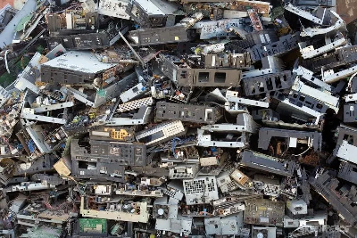
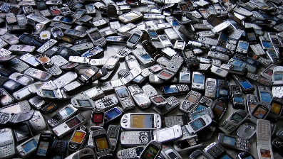
E - WASTE IN INDIA
Introduction
India (3.2 million tonnes) is third largest top e-waste generator in the world after China (10.1 million tonnes), and the USA (6.9 million tonnes). These countries together contributed 38% of total 53.6 million tonnes (Mt) of e-waste, generated worldwide in 2019.
Electronic Waste Management in India identified that computer equipment account for almost 70 % of e-waste, followed by telecommunication equipment phones (12 %), electrical equipment (8 %), and medical equipment (7 %) with remaining from household e-waste.

Slide 34
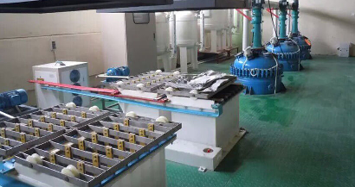
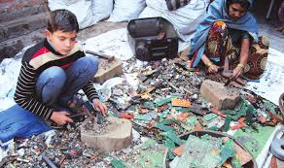
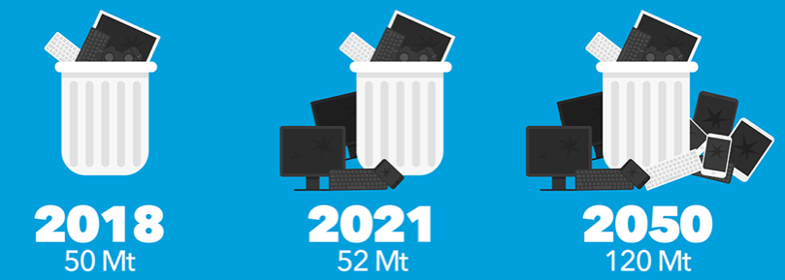
Central Pollution Control board reported by India collected just 10 per cent of the electronic waste (e-waste) estimated to have been generated in the country 2018-19 and 3.5 per cent of that in the generated in 2017-18.
Seelampur in Delhi is the largest e-waste dismantling centre of India. Adults as well as children spend 8–10 hours daily extracting reusable components and precious metals like copper, gold and various functional parts from the devices.
With COVID-19 keeping people indoors, the usage is only getting higher and without proper intervention, it is likely to be over 100 million tonnes by 2050.
METAL REFINE SYSTEM

Slide 35
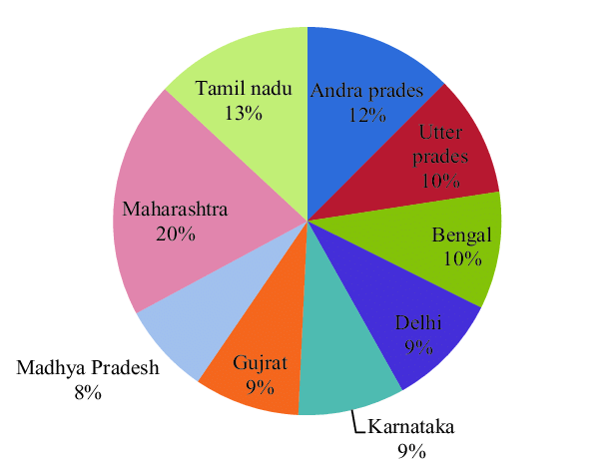
State and City wise Electronics Waste generation in India
In India, among top ten cities, Mumbai ranks first in generating e-waste followed by Delhi, Bangalore, Chennai, Kolkata, Ahmadabad, Hyderabad, Pune, Surat and Nagpur.
The 65 cities generate more than 60% of the total generated e- waste, whereas, 10 states generate 70% of the total e-waste.
State wise Generation of E-Waste

Slide 36
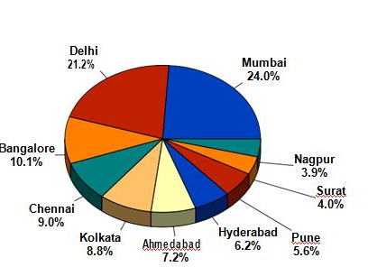
E-WASTE PILING UP
Mumbai at present tops the list
(1,000 kilograms, we will have 1 tonne)
Mumbai - 11, 017 tonnes
Delhi - 9,730 tonnes
Bangalore - 4,648 tonnes
Chennai - 4,132 tonnes
Kolkata - 4,025 tonnes
Ahmedabad - 3,287 tonnes
Hyderabad - 2,833 tonnes
Pune - 2,584 tonnes
Surat - 1,836 tonnes
City wise Generation of E-Waste

Slide 37
Enforcement Agencies in India
Ministry of Environment and Forests, Government of India is responsible in identification of hazardous wastes and provides permission to exporters and importers under the Environment (protection) Act, 1986.
Central Pollution Control Board (CPCB) was constituted under the Water (Prevention and Control of Pollution) Act, 1974. CPCB coordinates activities with the State Pollution Control Boards and ensures implementations of the conditions of imports. It also monitors the compliance of the conditions of authorization, import and export and conduct training courses for authorities dealing with management of hazardous wastes and to recommend standards for treatment, disposal of waste, leachate and specifications of materials and recommend procedures for characterization of hazardous wastes.

Slide 38
Enforcement Agencies in India
State Pollution Control Boards (SPCB) constituted under the Water (Prevention and Control of Pollution) Act, 1974 to grant and renew authorization, to monitor the compliance of the various provisions and conditions of authorization, to forward the application for imports by importers and to review matters pertaining to identification and notification of disposal sites.
Directorate General of Foreign Trade constituted under the Foreign Trade (Development & regulation) Act 1992 to grant/ refuse license for hazardous wastes prohibited for imports under the Environment (protection) Act, 1986.
Port Authorities and Customs Authorities under the customs Act, 1962 verify the documents and inform the Ministry of Environment and Forests of any illegal traffic and analyze wastes permitted for imports and exports and also train officials on the provisions of the Hazardous Wastes Rules and in analysis of hazardous wastes.

Slide 39
Case Studies
1.Guiyu in China
It is one the largest e-waste recycling site in the world. Approximately 10 million tons of e-waste are handled in each year.
2. Ghana in Africa
Mostly young people are aged 7 to 25 years old are working in this biggest plant.
3. West Delhi in India
Around 18.5 lakhs metric tons of e-waste are generated every year in India.

Slide 40
Guiyu in China
Often referred as e-waste capital of the world.
Most of the e-waste is imported
About 15,000 workers are working 16 hrs per day in dismantling and recovering the materials from e-waste without any precautions.
Workers also cook circuit boards to remove chips and solders, burn wires and other plastics to liberate metals such as copper; use highly corrosive and dangerous acid baths along the riverbanks to extract gold from the microchips; and sweep printer toner out of cartridges.
Dismantles 1.5 million pounds of discarded computers, cell phones and other electronics each year.
Earns about barely $1.50/day and relatively this tiny profit is enough motivation for workers to risk their health

Slide 41
Guiyu in China
80% of children are suffering from lead poisoning and are exposed to dioxins (highest amount in world) emitted during burning of e-waste.
Lead in blood of Guiyu Children is 54% higher on average than that of children in the nearby town.
Soil has been saturated with lead, chromium, tin, mercury, other heavy metals, dioxins, hydrocarbons and brominated compounds.
Rice cultivated village was now unable to produce crops for food and the river water(Linjaing River) is undrinkable.
Even the underground water is also completely polluted due to the leachates from dumped heaps of e-waste and hence the water for domestic purpose is trucked from somewhere else.
Lead and copper in road dust were 371 and 155 times higher, respectively, than nearby non e-waste sites.

Slide 42
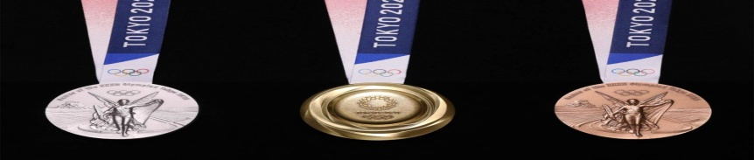
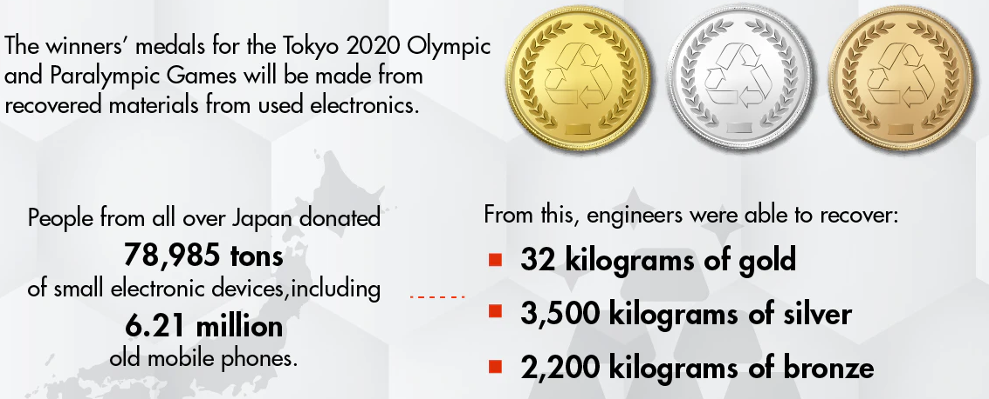
Tokyo Medal Project
Initiative started in 2017 and 100% metals (Gold, Silver & Bronze) was collected from people of Japan.
In 2016 Rio Olympics Brazil manufactured 30% of bronze and silver medal
Since 2014, Dell has used 100 million pounds of recovered materials in its products.
In 2016, Apple introduced its first iPhone-disassembly robot ‘Daisy’ that can breakdown 200 iPhones an hour.
Samsung collects and recycles about 100 million pounds of e-waste every year in the US alone.

Slide 43


